Slide 1
Clustering Assignment
Gaurav Garg

Slide 2
Problem Statement
An International humanitarian NGO raised around $10 million in recent funding. The CEO needs to decide how to use this money and which countries to help. From the analysis we need to find out countries which are in direst need of financial aid.

Slide 3
Data Understanding and Analysis
The data we have, has details of 167 countries across the world. It has details like child mortality, value of total exports, imports, health expenditure, GDP, etc.
Imports, exports and health are given as percentage of GDP per capita, so first step is to convert them to actual values.
After plotting seaborn pair plot between these variables we see that their individual distribution plot suggest that in most of the columns like income, imports, exports, gdp the values are left skewed i.e. there are many countries within lower ranges of these columns.
From the heat map we saw that imports and exports are highly correlated, similarly life_expec and child_mort also have high negative correlation coefficient
There are no null/NA values in any of the columns

Slide 4
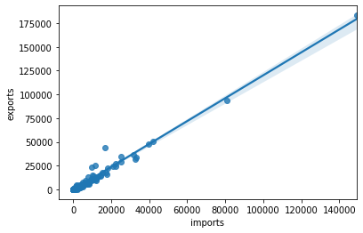
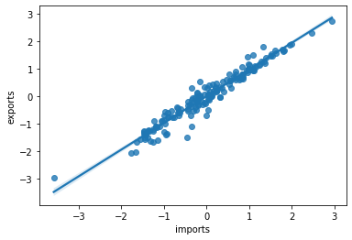
Transformation to log values
As most of the variable’s values are left skewed, if we convert them into log values we would get better dependency between the variables.
Before PowerTransformation
After PowerTranformation

Slide 5
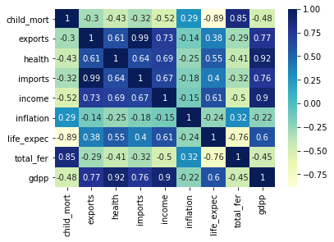
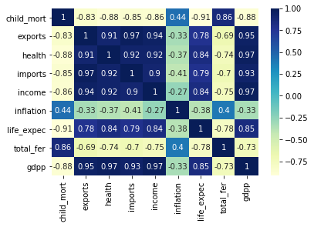
Heat Map

Slide 6
Modeling
K-Means and Hierarchical clustering both are used for clustering the dataset.
Almost similar results are obtained from both.
SSD and Silhouette Analysis are used to find out the optimal value of K.
Hopkins value obtained is around 0.80-0.85

Slide 7
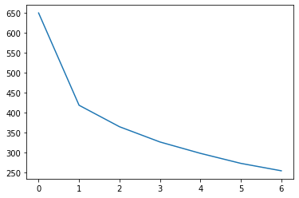
Sum of Square Differences
Below Curve is plotted for K=2 to K=8, in the below curve 0 represents 2, 1 represents 3 and so on.
From this curve, we can say that there is noticeably larger drop when value of K moves from 2 to 3 and K decreases less gradually after that.

Slide 8
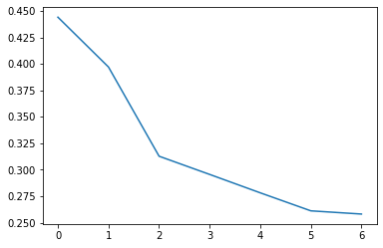
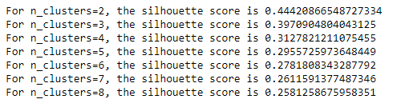
The Silhouette Analysis
Silhouette Analysis also supports the idea of K=3 or K=2.
Silhouette score is large for K=2, but we want a smaller set of countries to be able to predict which are direst need, therefore K=3 is finally chosen.

Slide 9
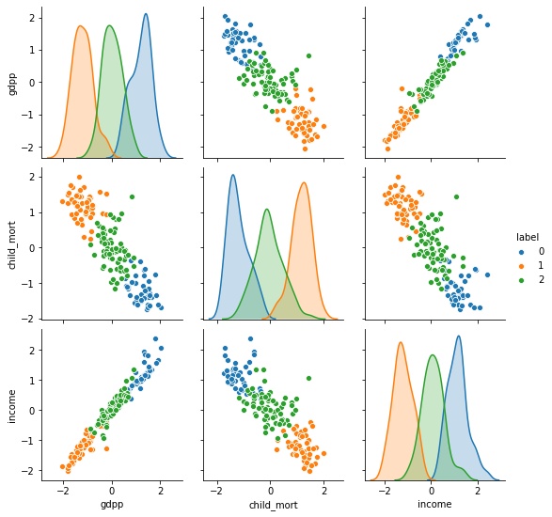
K-Means Clustering
K-means from sklearn.cluster library is used for K-means algorithm
From the obtained result from K=3, we see that K-means clustering has perfectly separated out countries based on the three desired variables of our analysis.

Slide 10
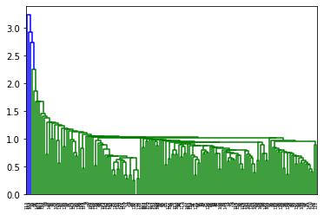
Hierarchical Clustering –single linkage
Again linkage, dendrogram and cut_tree libraries from scipy.cluster.hierarchy are chosen for the analysis
Single Linkage could not help much in prediction.
Below is the obtained dendrogram

Slide 11
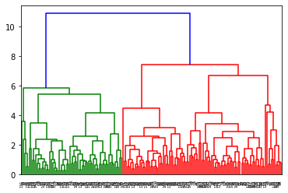
Hierarchical Clustering - Complete linkage
Complete linkage was very helpful in correct prediction.
Predictions from complete linkage were similar to K-means only difference was complete linkage predicted 17 more countries in the desired cluster (with high child_mort, low income and low gdpp).
Therefore finally, K-means predictions were chosen for results.

Slide 12
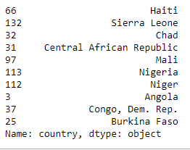
Result – final list of countries
Below is the final list of countries chosen to be given to CEO to provide financial aid.
From the 50 list of countries obtained from k-means clustering, top 10 are chosen based on the highest child_mort rate since child mortality is a very serious issue of a country and can be taken as most important.

